Slide 1
FPGA mining
Student: Ovidiu Panait
an III, CTI
Coordonator: Prof. dr. ing. Ioan Susnea

Slide 2
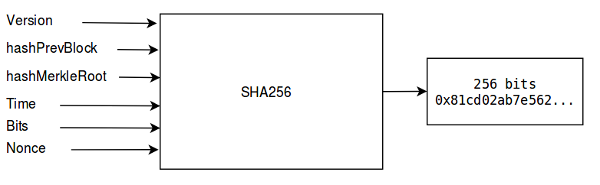
Bitcoin – algoritm
-crypto-moneda bazata pe algoritmul criptografic SHA256:
Version = Block version number
HashPrevBlock = 256-bit hash of the previous block header
HashMerkleRoot =256-bit hash based on all of the transactions in the block
Time = Current timestamp as seconds since 1970-01-01T00:00 UTC
Bits = Current target in compact format
Nonce = 32-bit number (starts at 0)
https://en.bitcoin.it/wiki/Block_hashing_algorithm

Slide 3
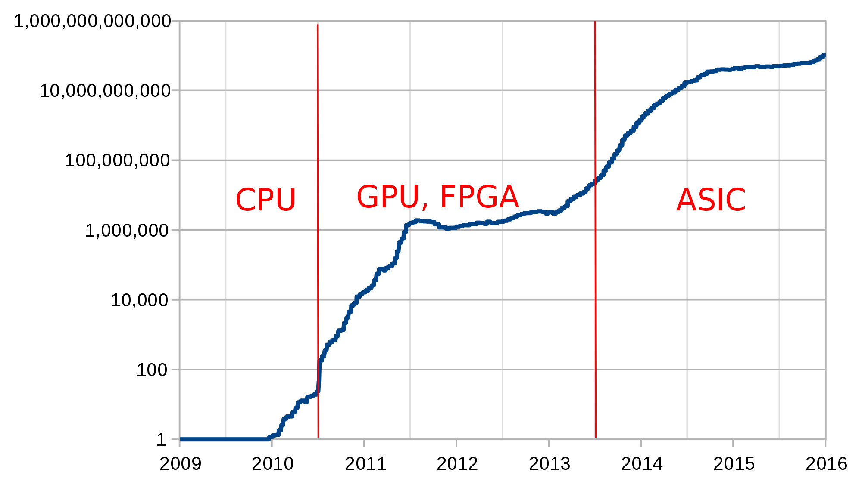
De ce FPGA?
- minatul pe CPU, chiar si cele high-end, produce rezultate de ordinul Khash/s
- FPGA-urile low-end pot atinge performante de ordinul Mhash/s

Slide 4
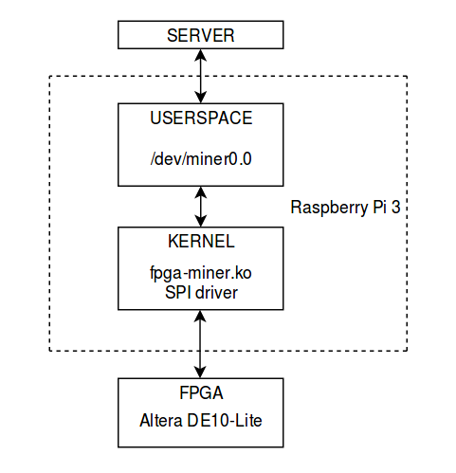
Implementare miner - schema bloc

Slide 6
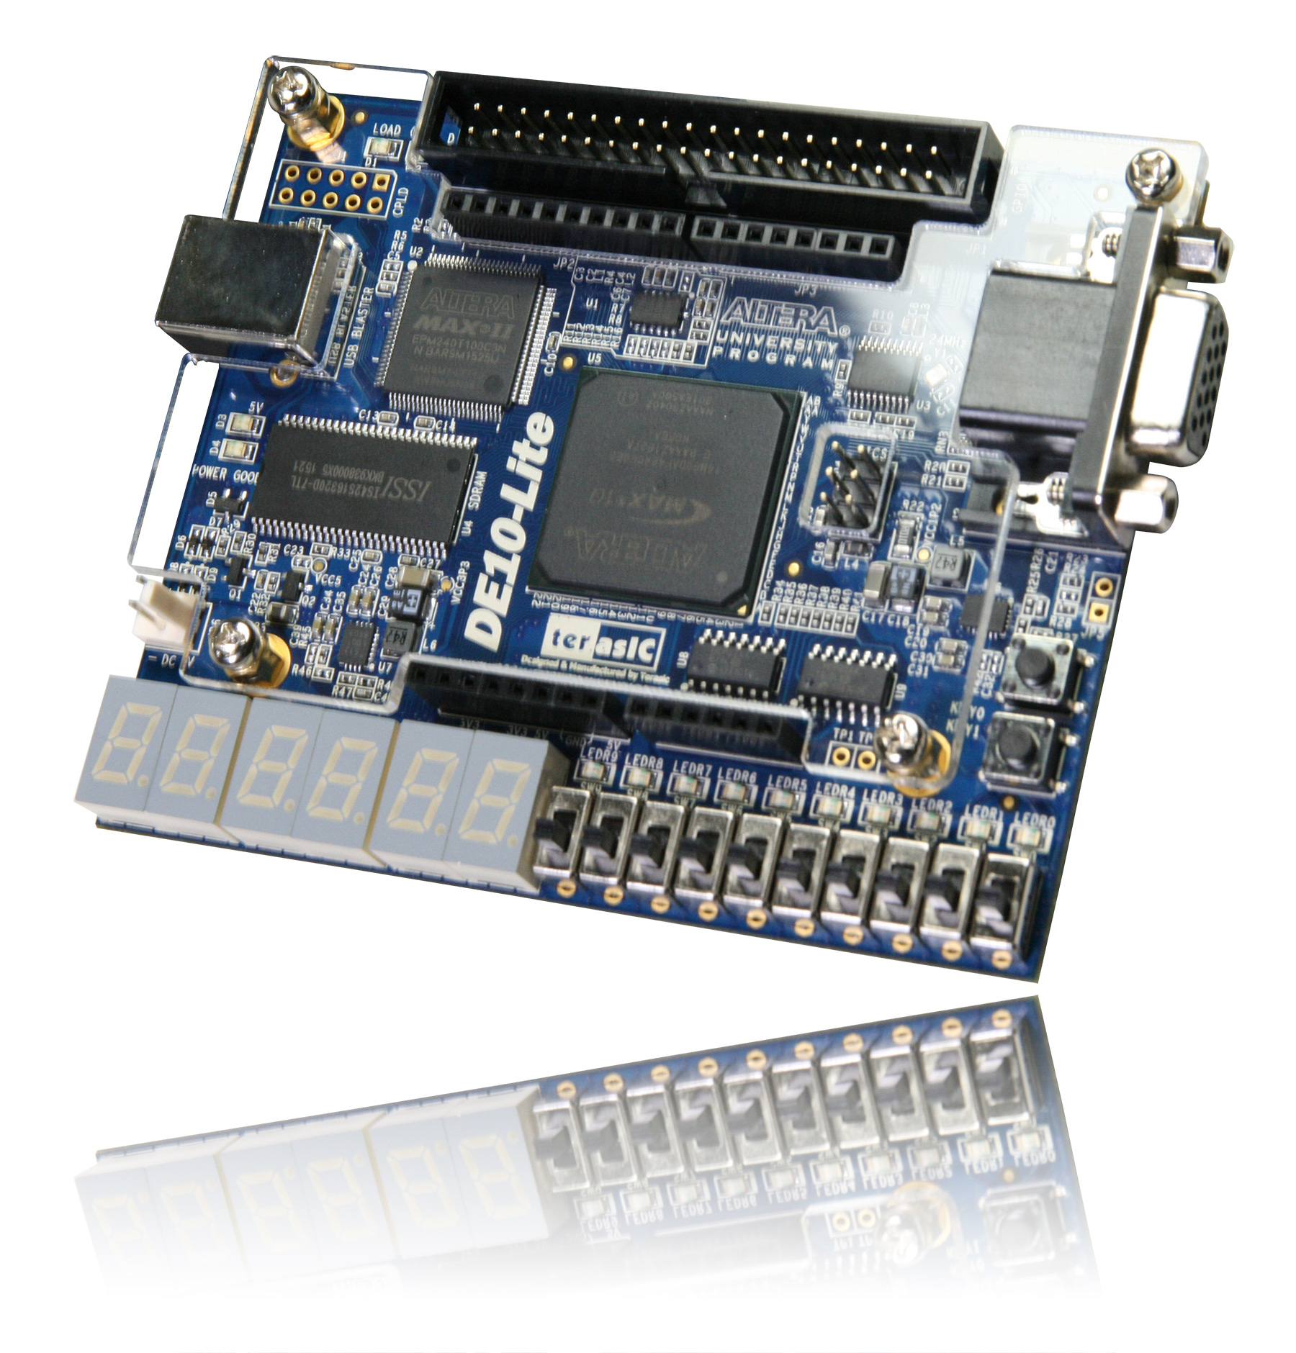
Rezultate
Altera DE10-Lite
Hashrate: 3 Mh/s
2 module SHA256 in paralel
50 MHz clock
Source code: https://github.com/ovpanait/FPGA/tree/master/Verilog/miner
Notes:
<number>

